Slide 1
SMAI Project
Rapid Object Detection using a Boosted Cascade of Simple Features
Geet Dasani - 2020102001
Arnav Pandey - 2020102016
Rajarshi Ray - 2020101127

Slide 2
Introduction
Goal: In the project, we aim to build a model for visual object detection using Adaboost and Cascading with simple features which processes images extremely rapidly and achieves high detection rates.
Three important contributions that make this project stand out. The first is the bringing of intermediate stage of a brand-new picture representation termed the "Integral Image," which enables the very speedy computation of the characteristics employed by our detector. The second is an AdaBoost-based learning algorithm that chooses a small number of crucial visual characteristics from a wider set and produces incredibly effective classifiers. The third contribution is a technique called "cascading" classifiers, which allows background portions of the picture to be swiftly eliminated while promising object-like regions receive longer processing time.

Slide 3
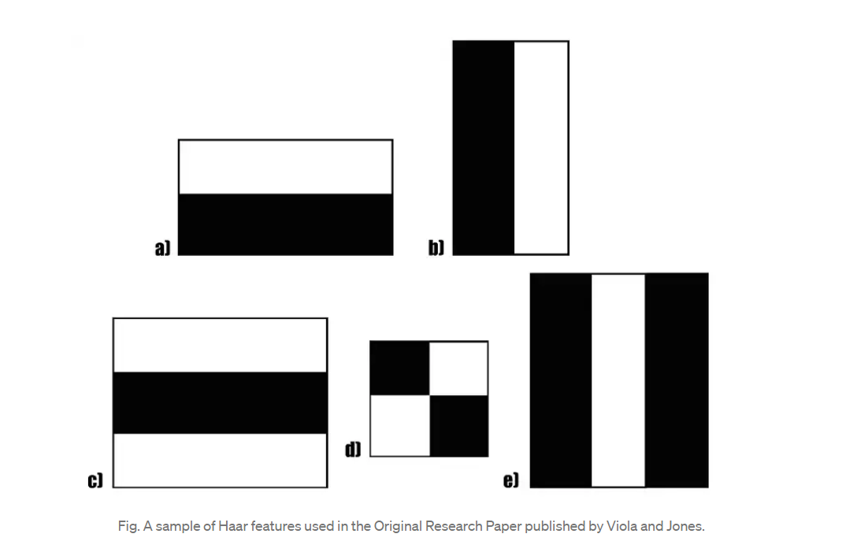
Features
More technically called Haar features.
Our object detection process divides photos into categories depending on the importance of basic attributes. We employ features rather than pixels because they may be used to encapsulate ad-hoc domain knowledge that is challenging to acquire with a limited amount of training data. The fact that this system functions far quicker than a pixel-based system adds a second crucial justification for features.
We essentially use 3 kinds of features:
The value of a two-rectangle feature is the difference between the sum of the pixels within two rectangular regions.
A three-rectangle feature computes the sum within two outside rectangles subtracted from the sum in a center rectangle.
Finally, a four-rectangle feature computes the difference between diagonal pairs of rectangles.

Slide 4
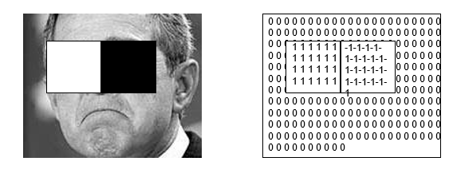
The first pair of rectangular characteristics is in charge of determining whether the edges are horizontal or vertical. Finding out whether a lighter zone is flanked by darker parts on each side or the opposite is the responsibility of the second set of three rectangular characteristics. The variation in pixel intensities across diagonals is determined by the third group of four rectangle characteristics.
Rectangle features can be computed very rapidly using an intermediate representation of the image which we call the integral image.

Slide 5
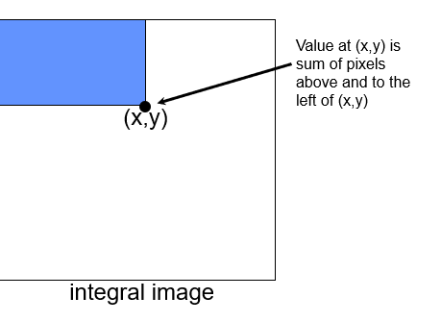

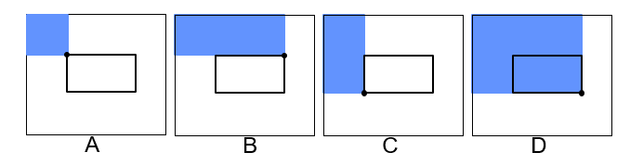
Integral Image:
In order to compute these features very rapidly at many scales we introduce the integral image representation for images. Once computed, any one of these Haar-like features can be computed at any scale or location in constant time.
The integral image at location (x,y) contains the sum of the pixels above and to the left of (x,y) inclusive.

Slide 6
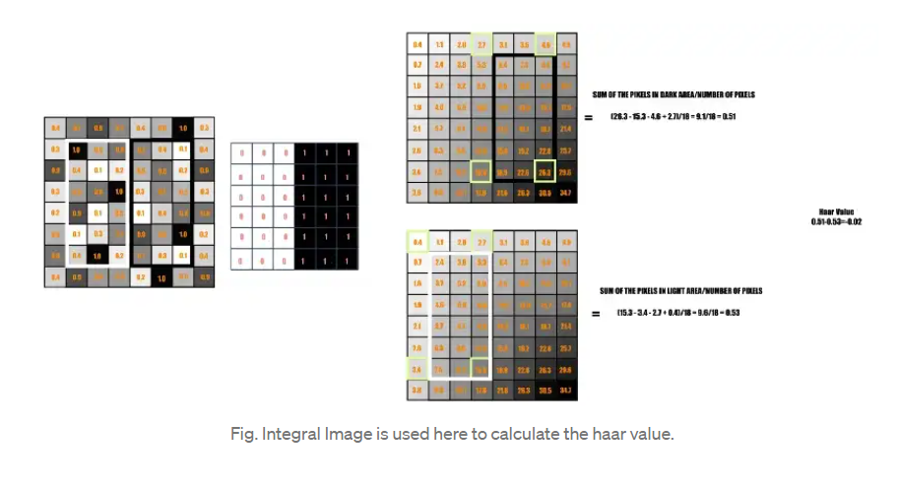
Any rectangular sum may be calculated in four array references using the integral image. The two-rectangle characteristics listed above can be calculated in six array references, eight for three-rectangle features, and nine for four-rectangle features since they include neighbouring rectangular sums.
In this case, the goal is to calculate the total of all the picture pixels located in the haar feature's darker and lighter areas, respectively. then ascertain what makes them different. The haar value will be closer to 1 if there is an edge in the image dividing bright pixels on the left from dark pixels on the right. In other words, if the haar value is closer to 1, we declare that an edge has been found. Since the haar number is distant from 1,

Slide 7
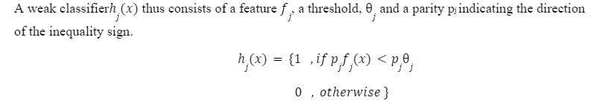
Learning Classification Purposes
Any variety of machine-learning techniques might be used to develop a classification function if there were a feature set and a training set of positive and negative pictures. The system will employ a modified version of AdaBoost to choose a constrained set of features and train the classifier.
The weak learning algorithm we plan on designing is to be made to select the single rectangle feature which best separates the positive and negative examples.
For each feature, the weak learner will determine the optimal threshold classification function, such that the minimum number of examples is misclassified.

Slide 8
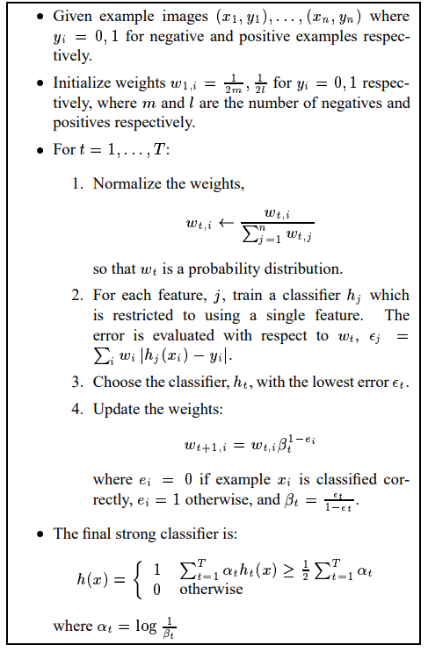
AdaBoost Algorithm
Start with a uniform weights on training examples.
For T rounds
Calculate Weighted error for each feature and pick best.
Re-write the examples:
Incorrectly Classified-More Weight
Correctly Classified- Less Weight
Final Classifier is the combination of the weak ones, weighted according to the error they had.

Slide 9
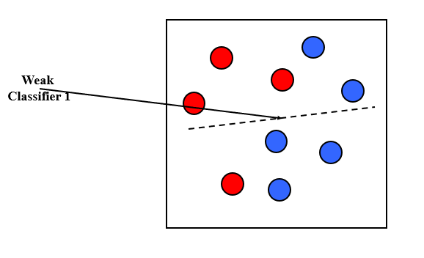
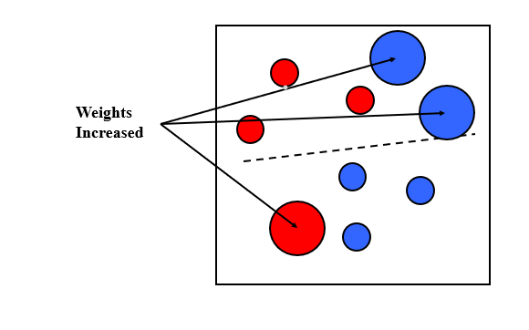
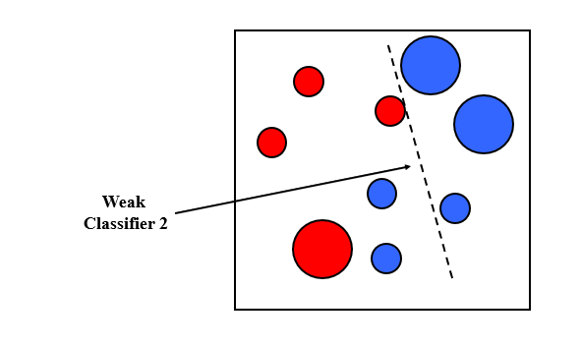
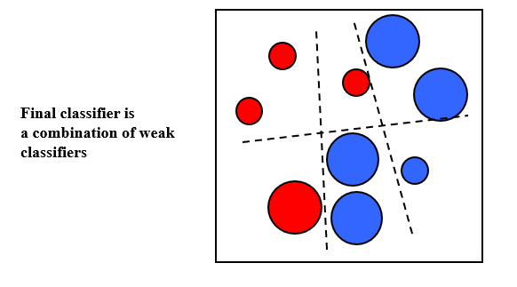
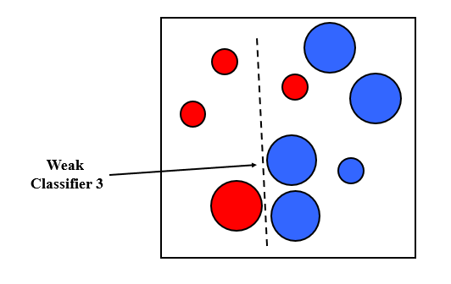
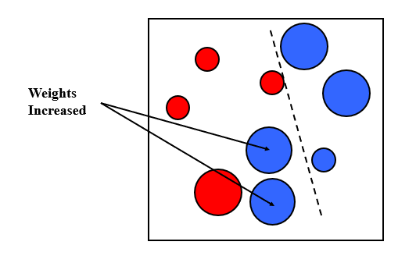

Slide 10
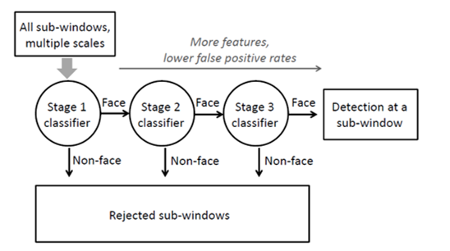
Cascading classifiers for detection
•Form a cascade with low false negative rates early on
•Apply less accurate but faster classifiers first to immediately discard windows that clearly appear to be negative
•Train with 5K positives, 350M negatives
•Real-time detector using 38 layer cascade
•6061 features in all layers

Slide 11
Timelines
Week 1: Understanding, analyzing the paper and micro-structuring forthcoming actions\
Week 2: Implementation on Integral Matrix and Feature reduction
Week 3: Week Classifiers and Cascading of Simple Features Week 4: Concluding efforts on work and finalizing project

